Slide 1



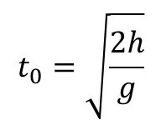
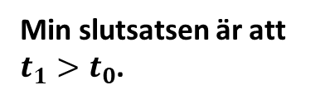


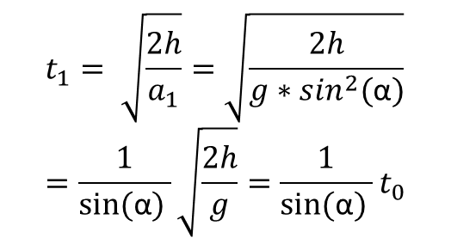




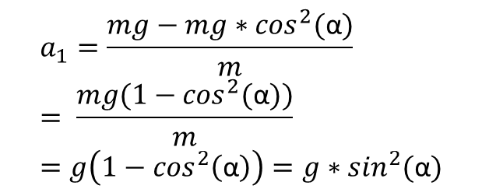



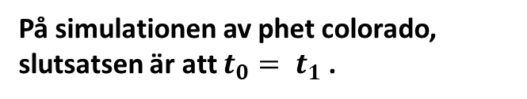

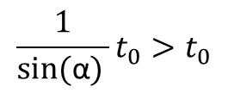
Fri fall vs fall på kurva
$$t_{0}$$
$$t_{1}$$
h
På simulationen av phet colorado, slutsatsen är att $t_{0}= t_{1}$.
$$a_{1}=\frac{mg−mg∗\cos^{2}(\text{α})}{m}= \frac{mg(1−\cos^{2}(\text{α}))}{m}=g\left(1−\cos^{2}\left(\text{α}\right)\right)=g∗\sin^{2}(\text{α})$$
$$0< sin\left(\text{α}\right)<1$$
$$0<\text{α}<90$$
$$F_{N}cos⁡(\text{α})$$
$$F_{N}$$
$$\frac{1}{sin⁡(\text{α}) }t_{0}>t_{0}$$
$$t_{0}$$
$$t_{1}$$
$$F_{N}sin⁡(\text{α})$$
h
$$t_{1}= \sqrt{\frac{2h}{a_{1}}}=\sqrt{\frac{2h}{g∗\sin^{2}(\text{α})}}=\frac{1}{sin⁡(\text{α}) }\sqrt{\frac{2h}{g}}=\frac{1}{sin⁡(\text{α}) }t_{0}$$
$$t_{1}>t_{0}$$
$$F_{G}$$
α
Min slutsatsen är att $t_{1}>t_{0}$.
$$t_{0}=\sqrt{\frac{2h}{g}}$$

